Slide 1
Database Management System
MySQL, PostgreSQL and SQL SERVER

Slide 2
WHAT IS A DATABASE?
A database is a set of data stored in a computer. This data is usually structured in a way that makes the data easily accessible.

Slide 3
WHAT IS A RELATIONAL DATABASE?
A relational database is a type of database. It uses a structure that allows us to identify and access data in relation to another piece of data in the database. Often, data in a relational database is organized into tables.

Slide 4
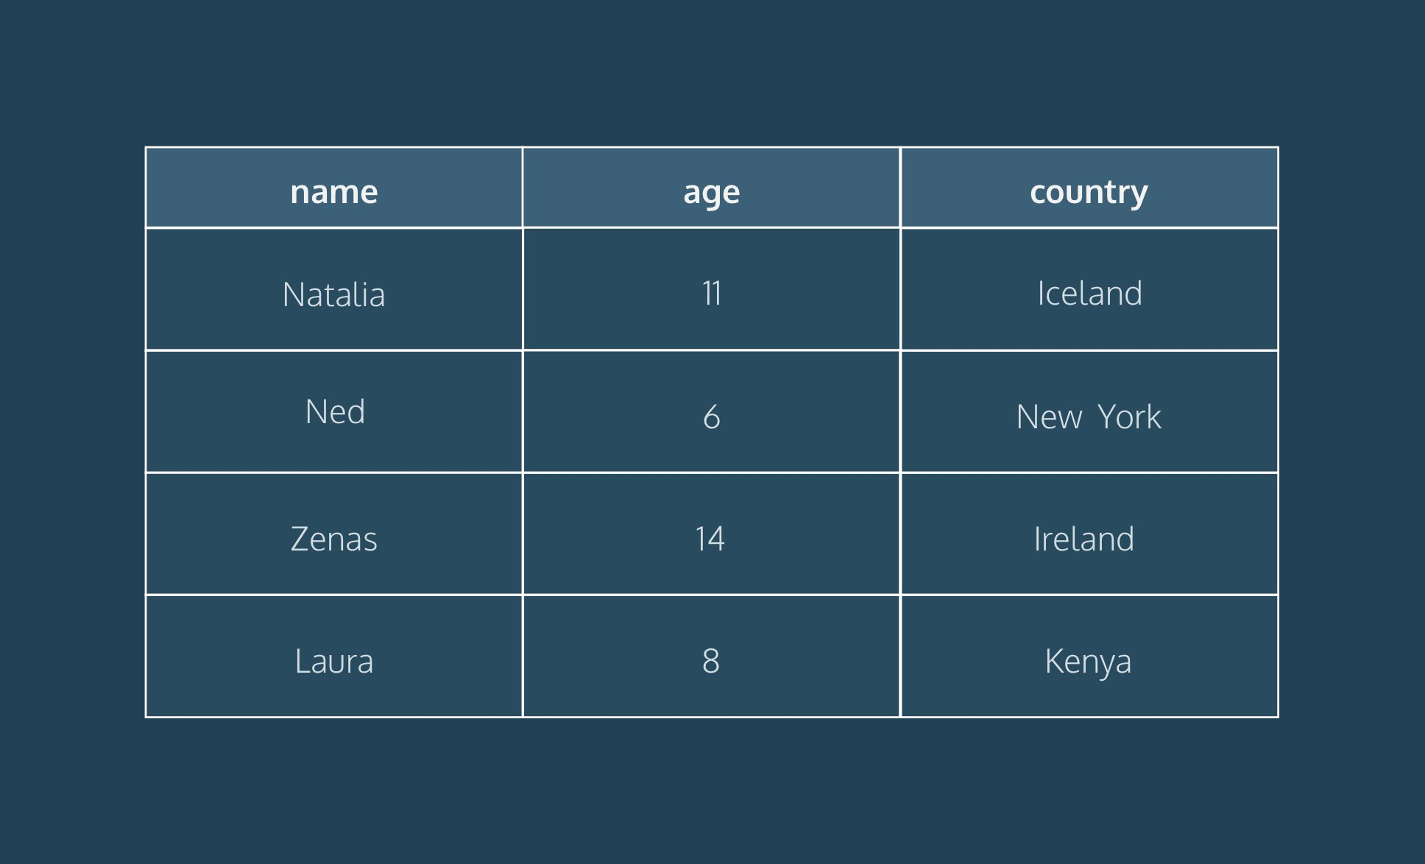
TABLES: ROWS AND COLUMNS
Tables can have hundreds, thousands, sometimes even millions of rows of data. These rows are often called records.
Tables can also have many columns of data. Columns are labeled with a descriptive name and have a specific data type.

Slide 5
WHAT IS A RELATIONAL DATABASE MANAGEMENT SYSTEM (RDBMS)?
A relational database management system (RDBMS) is a program that allows you to create, read,update, delete(crud)and administer a relational database. Most relational database management systems use the SQL language to access the database.

Slide 6
WHAT IS SQL?
SQL (Structured Query Language) is a programming language used to communicate with data stored in a relational database management system. SQL syntax is similar to the English language, which makes it relatively easy to write, read, and interpret.
Many RDBMSs use SQL (and variations of SQL) to access the data in tables

Slide 7
POPULAR RELATIONAL DATABASE MANAGEMENT SYSTEMS
SQL syntax may differ slightly depending on which RDBMS you are using. Here is a brief description of popular RDBMSs:
MySQL, PostgreSQL and SQL SERVER

Slide 8
WHAT IS MySQL ?
MySQL is a relational database management system (RDBMS) developed by Oracle that is based on structured query language (SQL). MySQL is integral to the most popular software stacks for building and maintaining everything from customer-facing web applications to powerful, data-driven B2B services. Its open-source nature, stability, and rich feature set, paired with ongoing development and support from Oracle. Internet-critical organizations such as Facebook, Flickr, Twitter, Wikipedia, and YouTube all employ MySQL backends.

Slide 9
Advantages of MySQL:
Data security;
On-demand scalability;
High performance;
Round-the-clock uptime;
Comprehensive transactional support;
Complete workflow control;
The reduced total cost of ownership;
The flexibility of open source.

Slide 10
WHAT IS PostgreSQL ?
PostgreSQL is a powerful, open-source object-relational database system that uses and extends the SQL language combined with many features that safely store and scale the most complicated data workloads.
PostgreSQL shares many of the same advantages of MySQL. It is easy to use, inexpensive, reliable and has a large community of developers. It also provides some additional features such as foreign key support without requiring complex configuration .

Slide 11
Advantages of PostgreSQL:
Supports the locking mechanism;
Has high availability;
Free and open-source software;
ACID-compliant;
Has the capacity for fault tolerance;
Supports image, video, audio storage and also supports graphical data;
Requires low maintenance;
Supports Multi-version concurrency control (MVCC);
High recovery;
Has user-defined data-types;
Table inheritance;
Runs on all operating systems.

Slide 12
WHAT IS SQL Server ?
SQL Server is a relational database management system, or RDBMS, developed and marketed by Microsoft. Similar to other RDBMS software, SQL Server is built on top of SQL, a standard programming language for interacting with the relational databases

Slide 13
Advantages of SQL Server:
Streamlined Installation;
Great Security Features;
Enhanced Performance;
Low Cost Of Ownership.

Slide 14
Comparison between the three RDBMS:
Some of MYSQL disadvantages are that it has been known to suffer from poor performance when scaling, open source development has lagged since Oracle has taken control of MySQL, and it does not include some advanced features that developers may be used to.
The main disadvantage of PostgreSQL is that it can be slower in performance than other databases such as MySQL. It is also slightly less popular than MySQL.
The main disadvantage of SQL Server IS Expensive pricing. Microsoft offers a free entry-level version called Express but can become very expensive as you scale your application.

Slide 15
CONCLUSION
Relational databases store data in tables. Tables can grow large and have a multitude of columns and records. Relational database management systems (RDBMSs) use SQL (and variants of SQL) to manage the data in these large tables. The RDBMS you use is your choice and depends on the complexity of your application.

Slide 16
THANK YOU !
Remember : “Learning to code is learning to create and innovate.”

